Slide 1





AIRBNB MARKET ANALYSIS
Presented by Team 5

Slide 2
PROBLEM STATEMENT
Gaining an understanding of the Airbnb industry is the main goal of this data analytics research. Important indicators that will be examined include pricing trends, demand-supply dynamics, customer preferences, and regional distribution.

Slide 3

DATASET PROVIDED
We have used the Airbnb-New York 2019 Dataset.
This dataset contains information regarding the Name of guest place, hostname and ID, neighbourhood area, room type, room price, minimum nights, number of reviews, reviews per month, host listings and availability throughout the year.
This dataset has useful information regarding distribution of room type availability and preference, hence can be used to draw insights about customer preferences and regional distribution of room types.

Slide 4
STEPS FOLLOWED
DATA CLEANING
EXPLORATORY DATA ANALYSIS
TABLEAU DASHBOARD
2
4
6
1
3
5
DATASET IMPORTED
DATA PRE-PROCESSING
FEATURE ENGINEERING

Slide 5
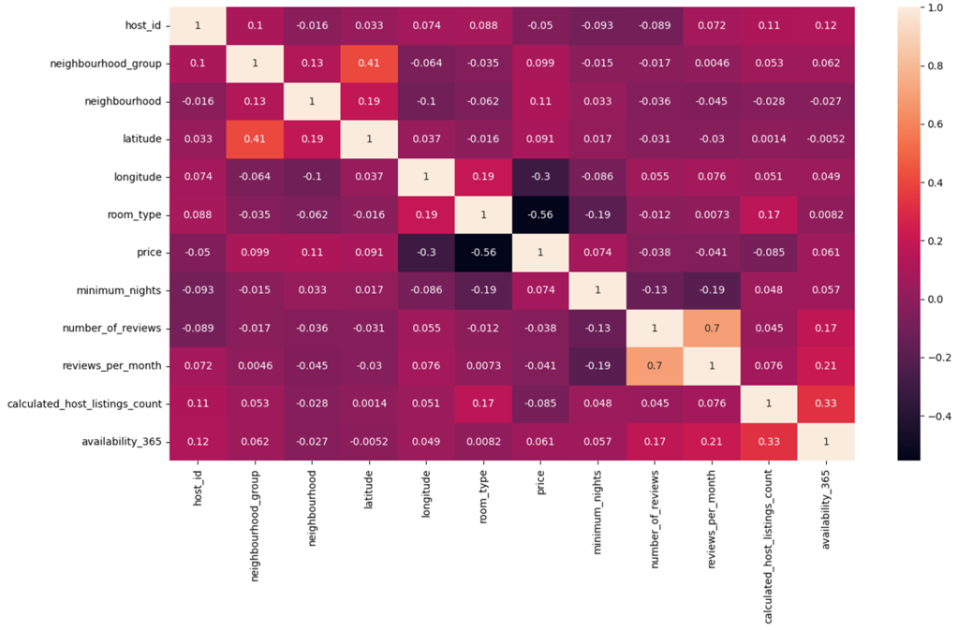
EXPLORATORY DATA ANALYSIS

Slide 6
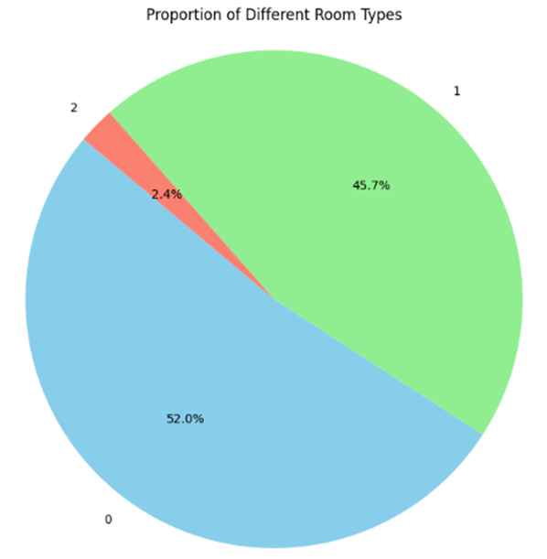

Slide 7
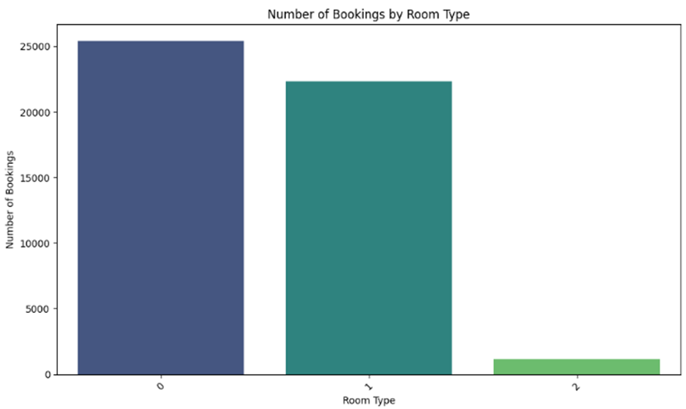

Slide 8
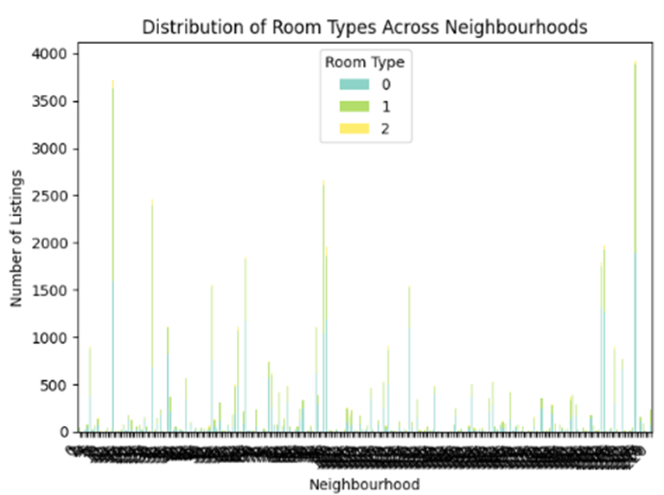

Slide 9
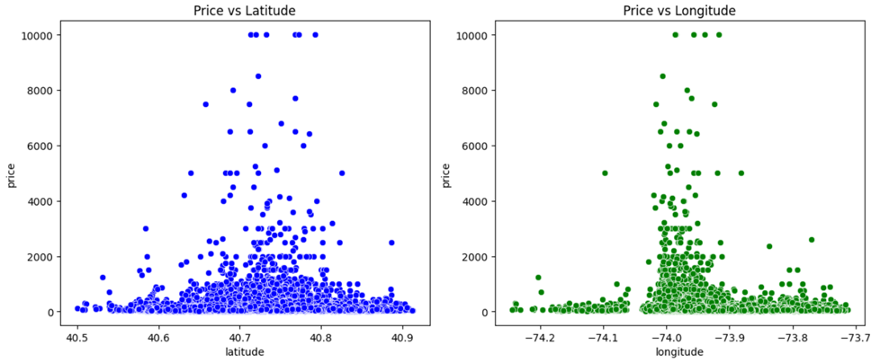
EXPLORATORY DATA ANALYSIS
PRICE ANALYSIS

Slide 10
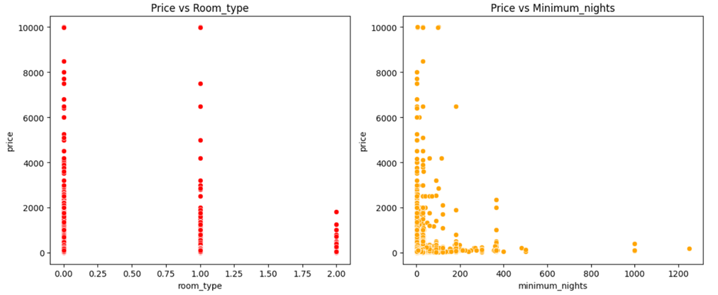
PRICE ANALYSIS

Slide 11
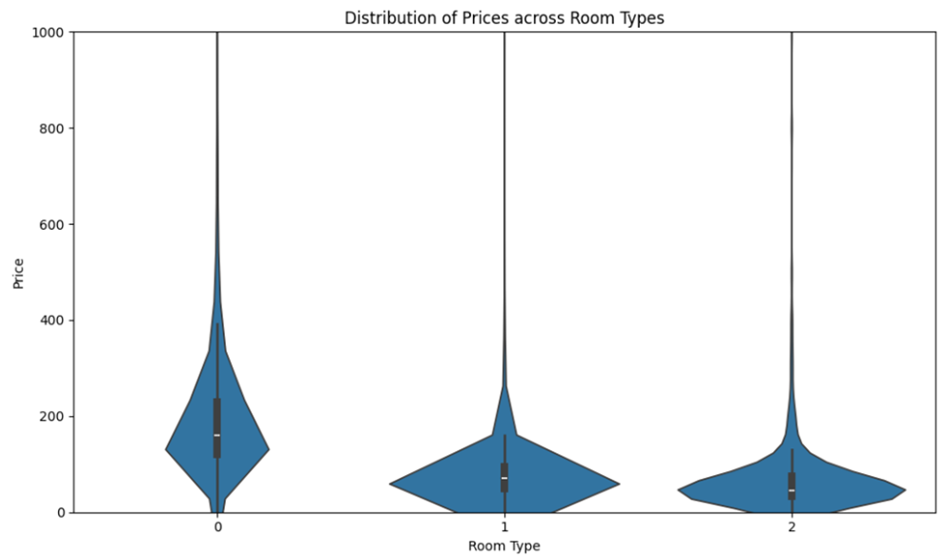
PRICE ANALYSIS - VIOLIN PLOT

Slide 12
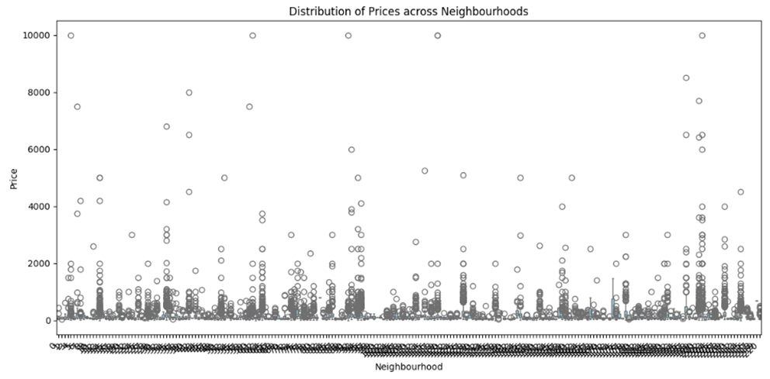
PRICE ANALYSIS - BOXPLOT

Slide 13
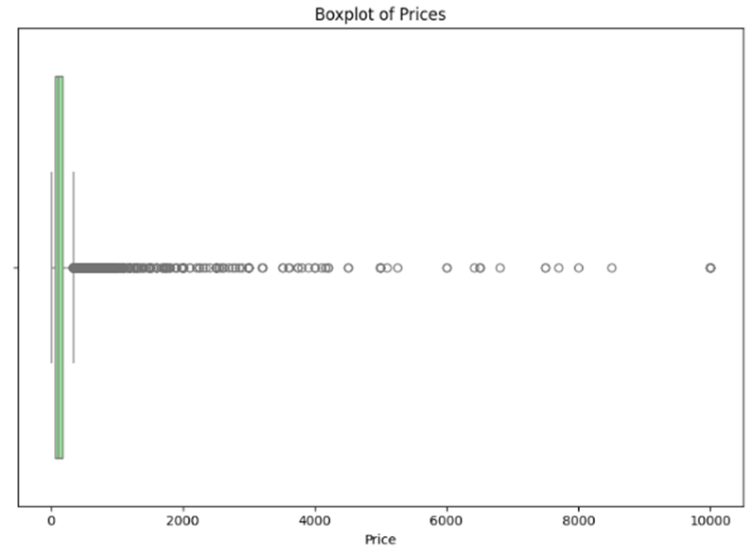
PRICE ANALYSIS - BOXPLOT
DETECTING OUTLIERS

Slide 14
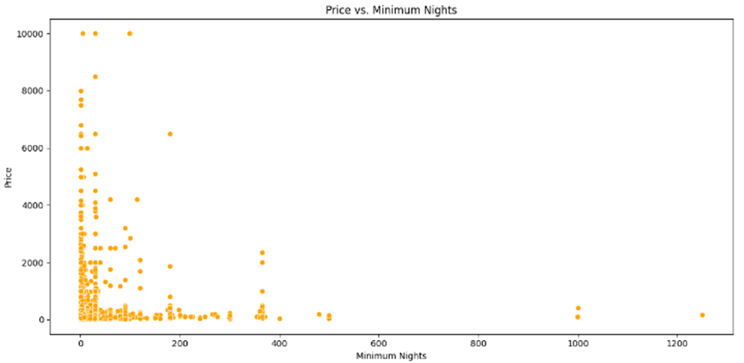
PRICE ANALYSIS - SCATTERPLOT USED TO IDENTIFY REASON BEHIND OUTLIERS

Slide 15
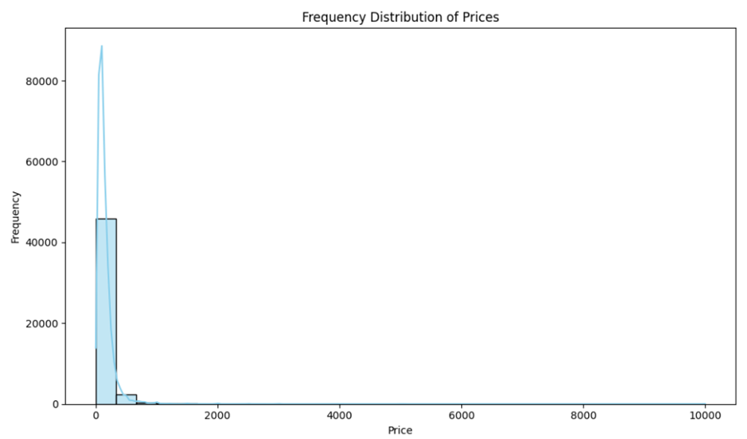
PRICE ANALYSIS - HISTOGRAM

Slide 16
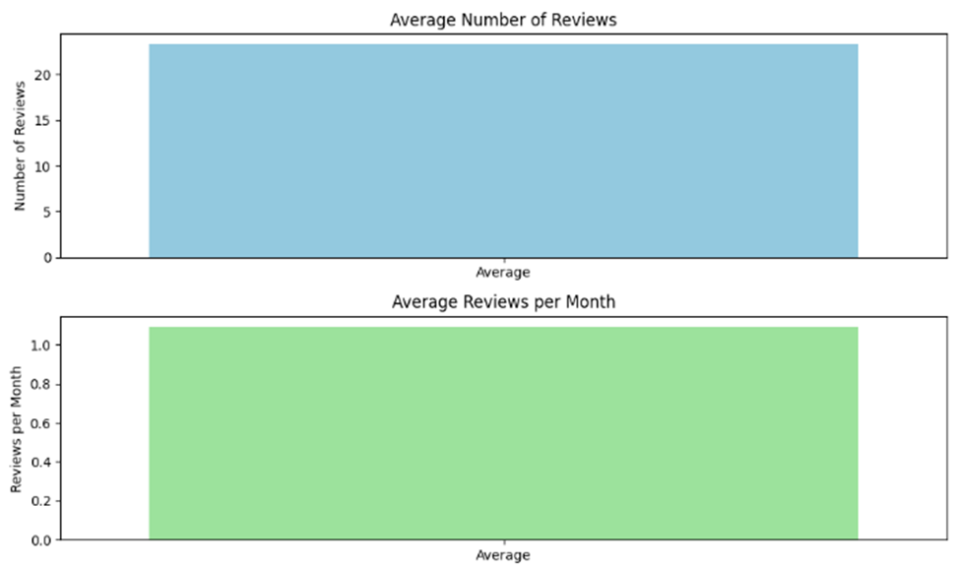
CUSTOMER FEEDBACK ANALYSIS - BARPLOT

Slide 17
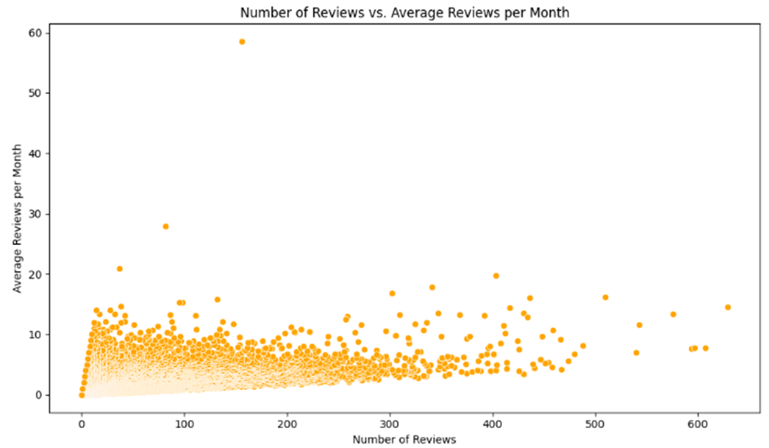
CUSTOMER FEEDBACK ANALYSIS - SCATTERPLOT

Slide 18
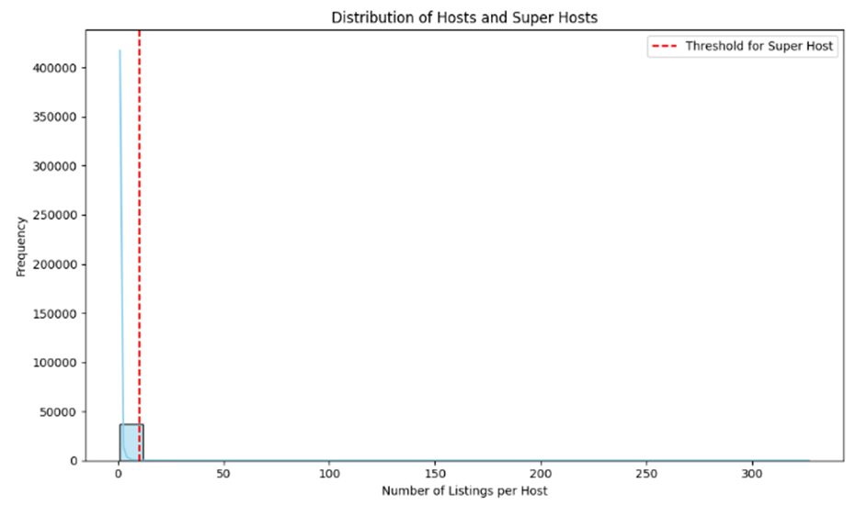
HOST ANALYSIS- HISTOGRAM

Slide 19
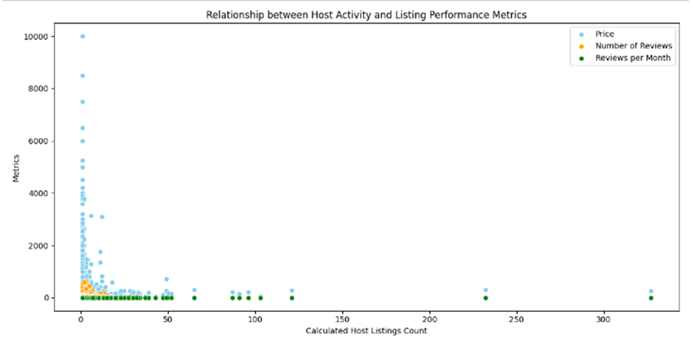
HOST ANALYSIS- SCATTER PLOT

Slide 20
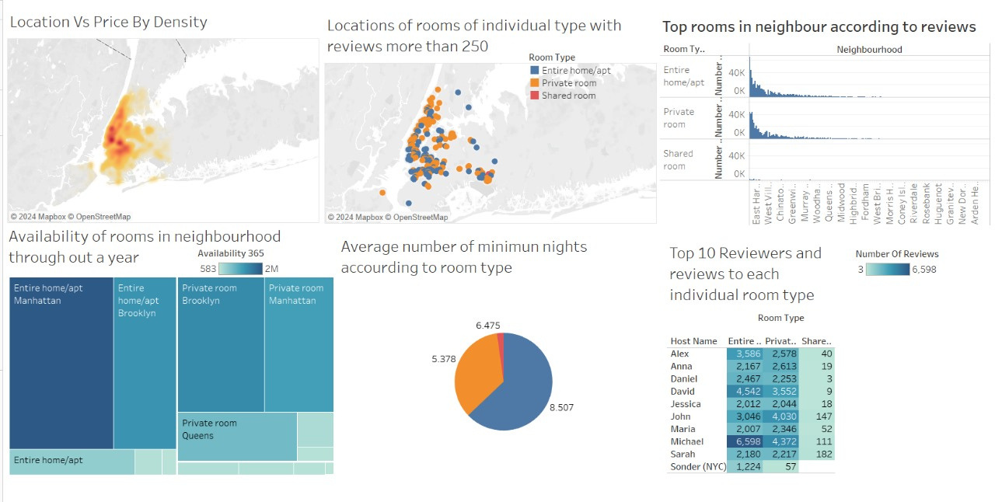
TABLEAU DASHBOARD

Slide 21
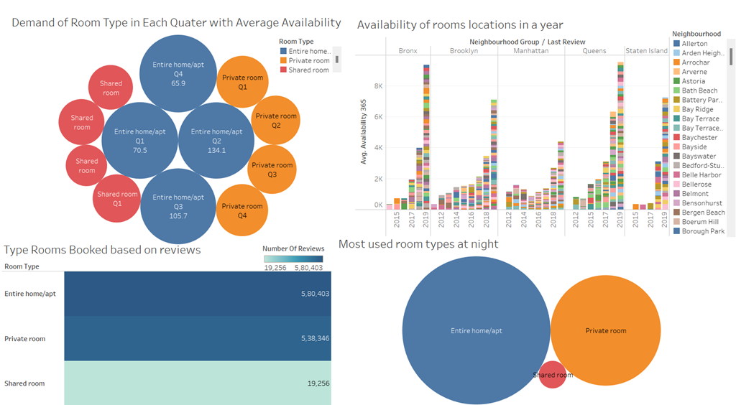
TABLEAU DASHBOARD

Slide 22
ACTIONABLE INSIGHTS AND RECOMMENDATIONS
·We observe that the most preferred room type is a Entire home/apartment followed by a Private room. Airbnb offering such room types are attracting guests and getting sufficient reviews. In comparison, Shared room availability is less. This area can be potentially attractive for Airbnb to capitalize on and expand its market share.
·To overcome pricing outliers dynamic pricing strategies can be implemented to incentivize bookings for the less-utilized room types like the shared rooms.
·Special promotions and incentives to be provided during off-peak periods to stimulate demand.

Slide 23
THANK YOU

